Slide 1

Megan Foran, Danny Jones, & Frank Moynihan
Dr. Bob Wilkinson, Ph.D.
Notes:
Hi everyone. My name is Daniel Jones, and I am part of team Teaching Heart along with Megan Foran and Frank Moynihan. Today I will be discussing out progressive research and the process to which we chose our final design. Again, we are looking to design a hands-on model of the left ventricular system and its periphery to demonstrate the effects of Frank-Starling’s Law to be used in organized instruction.

Slide 2
Brief Overview

Slide 3
Starling’s Law of the Heart
Preload increases → Cardiac Output increases → Transfer of blood from veins to arteries → Preload decreases
  Negative-feedback Loop
An increase in peripheral resistance causes an increase in preload
There is only one cardiac output that maintains constant venous return
Notes:
Starling’s Law dictates that an increase in preload, that is higher chamber volume prior to contraction, causes an increase in stroke volume. (and vice-versa with a decrease in preload). Peripheral resistance plays a role in this relationship because of its direct effect on preload. The greater the peripheral resistance, the greater the preload. It is also important to note that because preload goes down as arterial pressure (and thus blood stored there) goes up, there is a particular cardiac output for which venous return remains constant. An equilibrium value for this negative feedback loop.

Slide 4
Need
Starling’s Law can be difficult for cardiophysiology students to visualize
To aid comprehension, students need an interactive learning model to supplement the lecture and reading material
The model should allow the students to control the variables of mechanical circulatory regulation:
  Stroke Volume, Heart Rate, and Peripheral Resistance

Slide 5
Specific Design Requirements
Notes:
In order to address the needs of the client and his students, the device will conform to the following design specifications.

Slide 6
Design Specifications
Portable & Easy to Use
  2-5 kg; 1-2 m in circumference
Relatively Inexpensive (<$500)
Sustainable
Discrete structures
  Left ventricle, Arteries, Veins, Resistance Vessels (Capillary Bed)
Mechanical Pump (LV), controlled by student, supplies power to the system (SV: 100-200 ml)
Notes:
First, the device must be portable. The group has defined this as being between 2-5 kg, and 1-2 meters in circumference. Additionally, the device must be easy to use. The students may not come from a technical background, therefore the device, specifically any quantitative measurements, must be accessible to the average student. For our purposes, we assume no prior technical experience in our users. The device must cost less than $500 to construct. Also, the device must be sustainable. Dr. Wilkinson should not have to replace any components on a regular basis- the longevity of the components should be equal to that of the device. The device will have 4 discrete structures: a left ventricle, arteries, veins, and a capillary bed. Please note that for the remainder of the presentation, when I say “left ventricle” or “veins” etc, I am referring to the device component that models the respective biological structure. The model is intended to be an interactive tool, therefore the LV is a mechanical pump, controlled by the student, that provides power to the system. Moving forward, we aim for a pump with a stroke volume between 100-200ml to accurately model the heart.

Slide 7
Design Specifications
Veins 20-30 times more compliant than arteries
Variable resistance in capillary bed: (0,∞)
Variable fluid volume within the system: (0,3 L)
Pressure drops across arteries, capillary bed, and veins are approximately 7%, 92%, and 1% respectively (Smith, 1999)
Quantitative pressure measurements from within the system
Color gradation to illustrate oxygenation of the blood
Notes:
Additionally, the veins should be 20-30 times more compliant than the arteries- with a target value of 24 times greater. That is, the veins can accommodate large changes in pressure with relatively small changes in pressure. (C = deltaV/deltaP). The system must also have variable resistance within the capillary bed, ranging from 0 to infinity. The resistance is controlled by the student, such that they can experience the effects of different resistances on the pumping rates and intensities needed to maintain constant venous pressure. Additionally, the system should have a variable fluid volume for similar reasons. To most accurately model circulation the following pressure drops will occur in each of the three regions: arteries, veins, and the capillary bed. Finally, there will be quantitative pressure measurements from within the system. COLOR

Slide 8
Design Alternatives and Analysis

Slide 9
Elements of the Design
Fluid
Left Ventricle
Arteries and Veins
Resistance Vessels
Variable Resistance Mechanism
Notes:
In looking into various design alternatives, we split the model into these elements and analyzed each individually.

Slide 10
Fluid General Specs
Weight
Durable
Safety
Low Cost
Aesthetics
User-Friendly
Proximity to Actual Blood Density
Ease for Quantitative Measurements

Slide 11
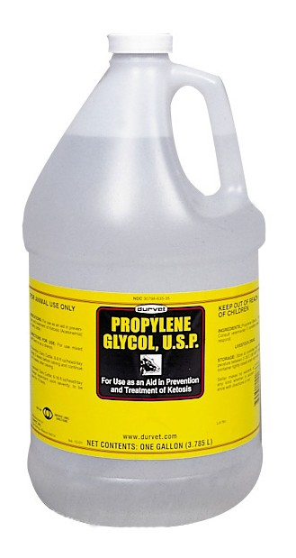
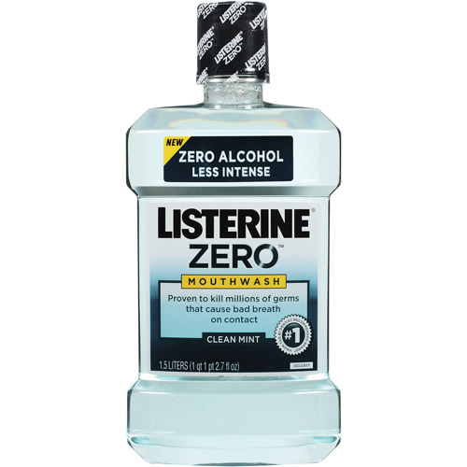
Fluid Ideas
(1)
Water
Compressed Air
Juice
Aqueous Glycol (1)
Vegetable Oil
Mouthwash (2)
(2)
Notes:
Eliminated Juice due to lack of userfriendliness (sugar/sticky)
Eliminated Vegetable oil due to its viscosity and lack of userfriendliness

Slide 12
Fluid Preliminary Pugh Chart

Slide 13
In-Depth Analysis: Fluid
Water
  Cheap and Plentiful
  Density: 1.00 g/cubic cm
  Safe and User Friendly
  Durable
  Eases Measurements
Aqueous Glycol
  Relatively Cheap
  Density: 1.04 g/cubic cm
  Safe and User Friendly
  Durable
  Eases Measurements

Slide 14
Fluid Final Pugh Chart

Slide 15
Left Ventricle General Specs
Lightweight
Durable
Low cost
Mechanical Input
Safety
Aesthetics
Compact Size
Feasibility of Quantitative Measurements/Output

Slide 16
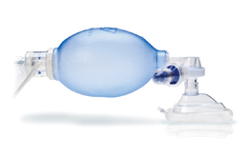
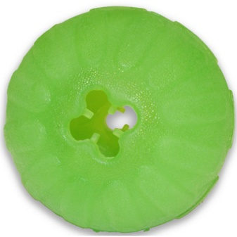
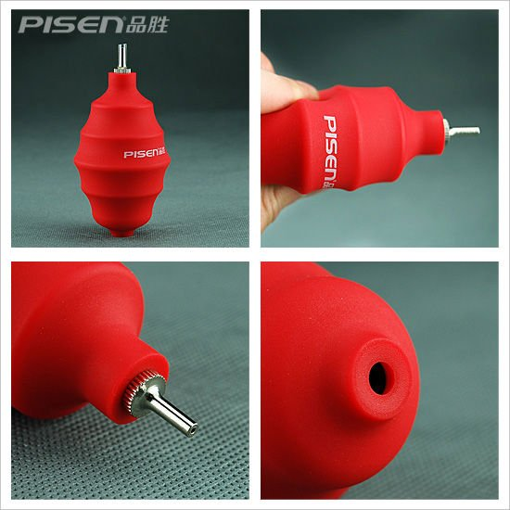
Left Ventricle Ideas
(1)
Manual Resuscitation Bag (1)
Punching Bag Balloon
Thin-Walled Elastomer Core (2)
PVC Blowing Balloon (3)
Water Pump
(2)
(3)

Slide 17
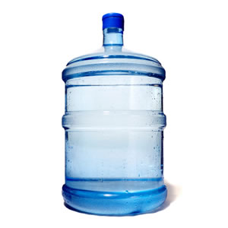
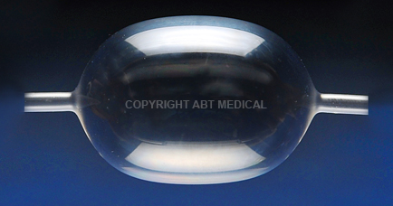
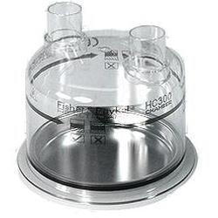
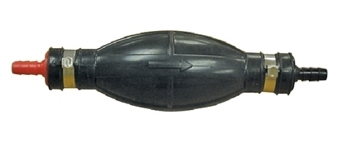
Left Ventricle Ideas
(1)
Water Dispenser Jug (1)
Plastic Water Bottle
Large Medical Balloons (2)
Humidifier Water Chamber (3)
Fuel Line Primer Bulb (4)
(2)
(3)
(4)

Slide 18
Left Ventricle Preliminary Pugh Chart

Slide 19
In-Depth Analysis: Left Ventricle
Reusable Manual Resuscitation Bag
  Durable; $150
  1500 mL; 0.4 kg
  Used with air; Volume Measurements
PVC Blowing Balloon
  Eliminated due to durability, size, and single opening
Fuel Line Primer Bulb (5/16”)
  Durable; $15-$20
  1000 mL
  Used with aqueous solution
  End Connections

Slide 20
Left Ventricle Final Pugh Chart

Slide 21
Arteries and Veins General Specs
Compact Size
Light Weight
Durable
Aesthetics
Feasibility of Quantitative Measurements
Compliance
Connections

Slide 22
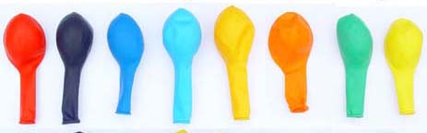
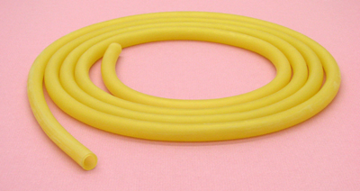
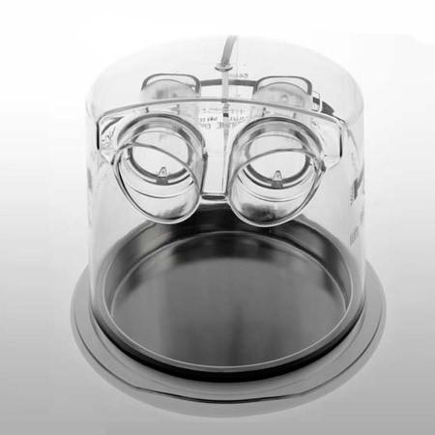
Arteries and Veins Ideas
Balloons
Tubing
Chambers

Slide 23
In-Depth Analysis: Arteries and Veins
Latex Balloons
  Very cheap; Size and Weight
  Qualitative compliance
  Not Durable
Urethane Balloons
  Increased Durability; Variable Compliance
  More expensive and too large
Latex Rubber Tubing
  Not Durable (<1 year)
  Variable Compliance

Slide 24
In-Depth Analysis: Arteries and Veins
Polyethylene Tubing
  Less compliant than latex
  More durable than latex
  Equivalent in Cost
Chambers
  Sustainable; Bulky/Not Aesthetic
  Quantitative Compliance
  Observable Volume Change
  Higher Cost with plugs, etc.

Slide 25
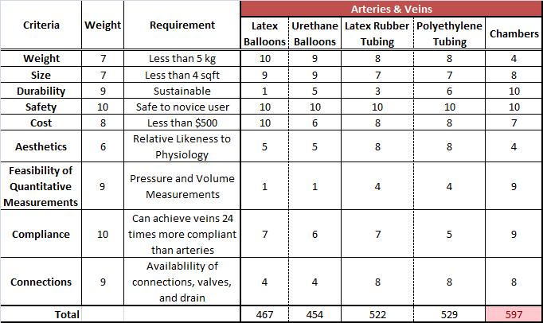
Arteries and Veins Pugh Chart

Slide 26
Resistance Vessels General Specs
Light Weight
Compact Size
Low Rigidity (able to bend)
Durable
Safety
Low Cost
Fittings

Slide 27
Resistance Vessels Pugh Chart
* Resistance Mechanism would decide final decision (Valves, Clamps, or Resistance Tubes)

Slide 28
Resistance Mechanism General Specs
Simplicity
Weight
Size
Durability
Cost
Resistance Range
User Friendly
Aesthetics
Availability of Fittings

Slide 29
Resistance Vessels Pugh Chart
* Resistance Vessels are thus nylon tubes due to the plethora of valve connector options

Slide 30
Chosen Design
Notes:
With these current solutions, as well as the specifications for our design, the Teaching Heart team’s next steps are to generate several and select one design. To achieve the December deadline, the team has created a project schedule seen here.

Slide 31
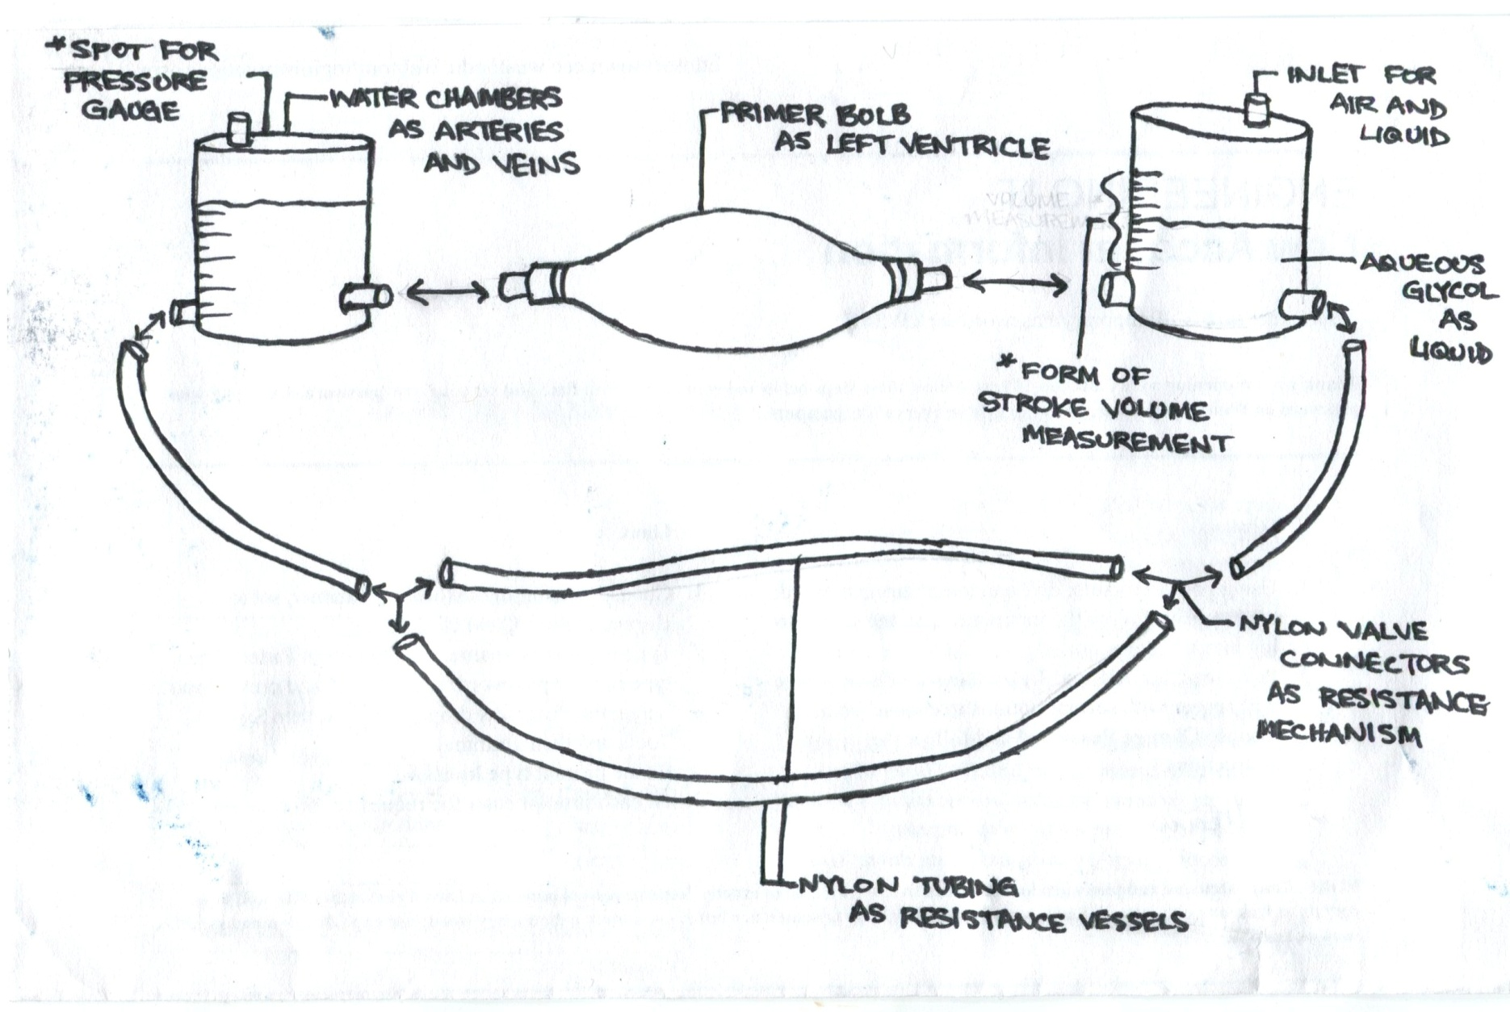
Rough Diagram of Chosen Design

Slide 32
Analyses Needed to Complete Design
Best Ways to Secure Connections
Devise Method for determining Stroke Volume
Pressure Measurements via Chambers
Calculating Desired Length and Diameter of Vessels in Periphery
Best Method to Vary Pressure in Chambers to Simulate Compliance
Optional: Color Gradation

Slide 33
Team Organization
Notes:
With these current solutions, as well as the specifications for our design, the Teaching Heart team’s next steps are to generate several and select one design. To achieve the December deadline, the team has created a project schedule seen here.

Slide 34
Project Schedule
Notes:
The schedule includes all tasks and milestones throughout the design process. It indicates working periods for the various tasks, as well as the specific deadlines.

Slide 35
Organization of Responsibilities
Team Teaching Heart
Meet Weekly
Prepare Written Reports
Compile Weekly Reports
Megan
Preliminary Presentation
Project Management
Pressure Measurements
Danny
Progress Presentation
WebMaster
Volume Measurements
Frank
Final Presentation
DesignSafe Report
Vessels (Connections and Dimensions)
Notes:
In addition to creating a schedule, the team has worked together to create a division of responsibilities that best utilizes the strengths of each team member. Collectively, the team meets weekly to check-in on current progress and compile the weekly status reports. Additionally, the team works together to prepare the written reports.

Slide 36
Works Cited
"Hygenic Rubber Latex Tubing." Medical Supplies - Discount Medical Supplies and Equipment at JRSmedical.com. JRS Medical, n.d. Web. 16 Oct. 2012.<http://www.jrsmedical.com/>.
"Latex Tubing - Frequently Asked Questions." Natural Rubber Latex Tubing. Web. 16 Oct. 2012. <http://www.kentelastomer.com/latex-tubing-faq>.
"Sustainability." Polyurethanes. American Chemistry Council, n.d. Web. 17 Oct. 2012. <http://polyurethane.americanchemistry.com/>.
"Primer Bulb." EPA Certified S : Attwood Marine. Attwood Marine Products, 2012. Web. 21 Oct. 2012. <http://www.attwoodmarine.com/store/product/epa-certified-primer-bulb>.
"Resuscitation Bags." Resuscitation Bags. Ventlab Corporation, 2003. Web. 21 Oct. 2012. <http://www.ventlab.com/Resuscitation.htm>.
Smith, A. M. "A Model Circulatory System for Use in Undergraduate Physiology Laboratories." Advances in Physiology Education 22.1 (1999): S92-99. PubMED. Web. 16 Sept. 2012.
Timms, Daniel, Mark Hayne, Keith McNeil, and Andrew Galbraith. "A Complete Mock Circulation Loop for the Evaluation of Left, Right, and Biventricular Assist Devices." Artificial Organ 29.7 (2005): 564-72. Queensland University of Technology. Web. 15 Sept. 2012.
US Plastic. Web. 8 Oct. 2012. <www.usplastic.com>.

Slide 37
Questions?

