Slide 1
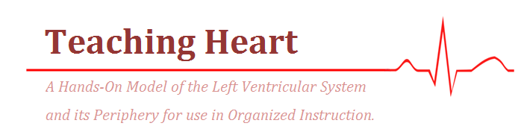
Megan Foran, Danny Jones, & Frank Moynihan
Dr. Bob Wilkinson, Ph.D.
Notes:
Hi everyone. My name is Megan Foran, and I am part of team Teaching Heart along with Danny Jones and Frank Moynihan. Today I will be discussing the preliminary research and design work for our project. We are working to design a hands-on model of the left ventricular system and its periphery to demonstrate the effects of Starling’s Law to be used in organized instruction.

Slide 2
Background
Notes:
First, I will give some background information on the pertinent cardiovascular principles governing our design.

Slide 3
Introduction
The circulatory system is regulated by mechanical as well as nervous & hormonal feedback systems
Mechanical control is governed by relationship between peripheral resistance, preload, stroke volume, & cardiac output.
Notes:
In general, the circulatory system is regulated by mechanical, as well as nervous and hormonal feedback systems. The purpose of this model is to demonstrate the negative-feeback mechanical control. This feedback loop is governed by the relationship between stroke volume, preload, and peripheral resistance. Stroke volume is the amount of blood that flows out of the ventricles during contraction. Preload is the initial stretching of cardiac myocytes before contraction- which is related to the chamber volume just before contraction. Finally, peripheral resistance it the ratio of mean arterial blood pressure to volumetric flow rate of blood. These variables governing the mechanics of circulation through the heart are related through Frank-Starling’s Law.

Slide 4
Starling’s Law of the Heart
Preload increases → Cardiac Output increases → Transfer of blood from veins to arteries → Preload decreases
  Negative-feedback Loop
An increase in peripheral resistance causes an increase in preload
There is only one cardiac output that maintains constant venous return
Notes:
Starling’s Law dictates that an increase in preload, that is higher chamber volume prior to contraction, causes an increase in stroke volume. (and vice-versa with a decrease in preload). Peripheral resistance plays a role in this relationship because of its direct effect on preload. The greater the peripheral resistance, the greater the preload. It is also important to note that because preload goes down as arterial pressure (and thus blood stored there) goes up, there is a particular cardiac output for which venous return remains constant. An equilibrium value for this negative feedback loop.

Slide 5
Need
Starling’s Law can be difficult for cardiophysiology students to visualize
To aid comprehension, students need an interactive learning model to supplement the lecture and reading material
The model should allow the students to control the variables of mechanical circulatory regulation:
  Stroke Volume, Heart Rate, and Peripheral Resistance

Slide 6
Project Scope
To address this need, the Teaching Heart team will design a hand-operated, portable device that is easily manipulated by a single user
This mechanical model is intended for use by medical instructors and students, modeling circulation through the left ventricle and its periphery
The purpose of this device is to illustrate the mechanical negative-feedback control of cardiac output and arterial pressure governed by Frank-Starling’s Law

Slide 7
Specific Design Requirements
Notes:
In order to address the needs of the client and his students, the device will conform to the following design specifications.

Slide 8
Design Specifications
Portable & Easy to Use
  2-5 kg; 1-2 m in circumference
Relatively Inexpensive (<$500)
Sustainable
Discrete structures
  Left ventricle, Arteries, Veins, Resistance Vessels (Capillary Bed)
Mechanical Pump (LV), controlled by student, supplies power to the system (SV: 100-200 ml)
Notes:
First, the device must be portable. The group has defined this as being between 2-5 kg, and 1-2 meters in circumference. Additionally, the device must be easy to use. The students may not come from a technical background, therefore the device, specifically any quantitative measurements, must be accessible to the average student. For our purposes, we assume no prior technical experience in our users. The device must cost less than $500 to construct. Also, the device must be sustainable. Dr. Wilkinson should not have to replace any components on a regular basis- the longevity of the components should be equal to that of the device. The device will have 4 discrete structures: a left ventricle, arteries, veins, and a capillary bed. Please note that for the remainder of the presentation, when I say “left ventricle” or “veins” etc, I am referring to the device component that models the respective biological structure. The model is intended to be an interactive tool, therefore the LV is a mechanical pump, controlled by the student, that provides power to the system. Moving forward, we aim for a pump with a stroke volume between 100-200ml to accurately model the heart.

Slide 9
Design Specifications
Veins 20-30 times more compliant than arteries
Variable resistance in capillary bed: (0,∞)
Variable fluid volume within the system: (0,3 L)
Pressure drops across arteries, capillary bed, and veins are approximately 7%, 92%, and 1% respectively (Smith, 1999)
Quantitative pressure measurements from within the system
Color gradation to illustrate oxygenation of the blood
Notes:
Additionally, the veins should be 20-30 times more compliant than the arteries- with a target value of 24 times greater. That is, the veins can accommodate large changes in pressure with relatively small changes in pressure. (C = deltaV/deltaP). The system must also have variable resistance within the capillary bed, ranging from 0 to infinity. The resistance is controlled by the student, such that they can experience the effects of different resistances on the pumping rates and intensities needed to maintain constant venous pressure. Additionally, the system should have a variable fluid volume for similar reasons. To most accurately model circulation the following pressure drops will occur in each of the three regions: arteries, veins, and the capillary bed. Finally, there will be quantitative pressure measurements from within the system. COLOR

Slide 10
Exploration of Existing Solutions
Notes:
Before designing a teaching model to meet the previously mentioned specifications, it is important for our team to understand what solutions are currently in the marketplace.

Slide 11
Dr. Wilkinson’s Heart Teaching Model
Original prototype created at WUSTL Medical School
Developed to model Frank-Starling’s Law of Heart
Contains:
  Mock Left Ventricle
  Arteries
  Veins
  Resistance Vessels (ie. Capillary Bed)
Compliance
  Veins 24 times more compliant than arteries
Notes:
The first logical model to analyze is Dr. Wilkinson’s own prototype. He developed the model for his physiology course in the medical school and uses it to aid instruction. The current prototype contains the same 4 discrete structures and varied compliance bewteen the veins and arteries.

Slide 12
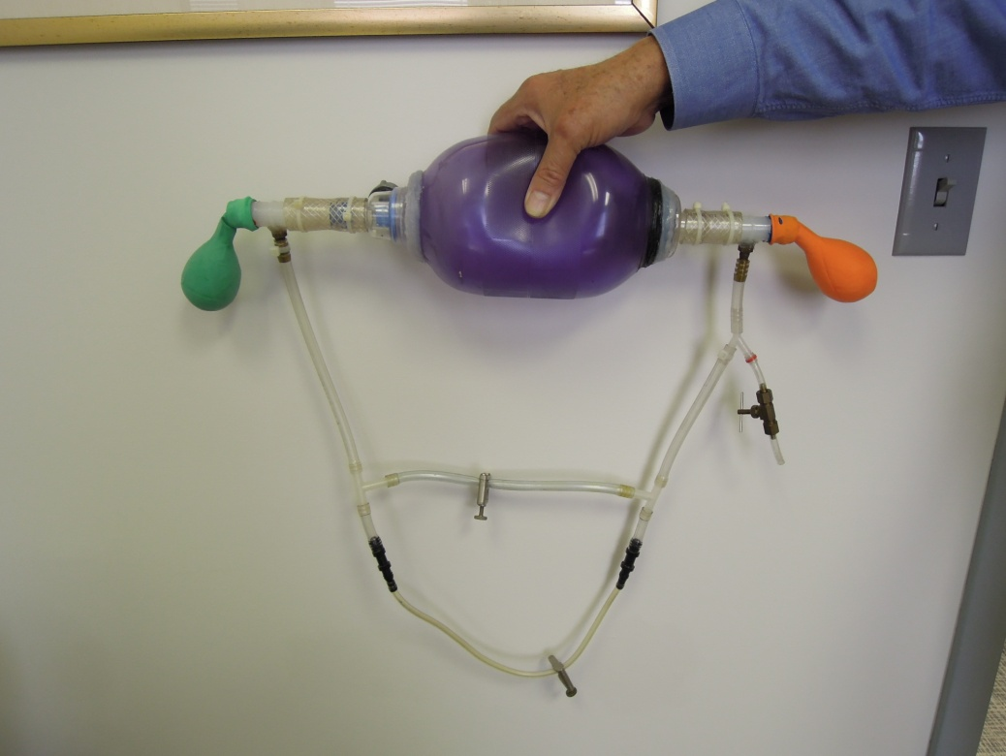
Image of Dr. Wilkinson’s Model
Notes:
Pictured here is Dr. Wilkinson’s prototype. He uses a resuscitation bag to model the left ventricle. On either side are latex balloons to represent the veins and arteries. The artery has 2 balloons, one encased in the other, to model the increased compliance of the veins relative to the arteries. Latex tubing and brass fittings make out the capillary bed (with 2 capillary tubes). Each has a metal clamp that can be opened/closed to vary the resistance. The fluid within the system is compressed air, which is pumped into the system via the inlet valve seen here.

Slide 13
Detailed Drawing of Dr. Wilkinson’s Model
Notes:
Here is a detailed drawing of this same model.

Slide 14
Specifications for Dr. Wilkinson’s Model
Dr. Wilkinson’s Heart Teaching Model Specifications
Size | Approx. 0.5 m x 0.5 m
Weight | Approx. 2 kg
Fluid | Compressed air
Power | Mechanical
Pressure Measurements | None
Notes:
The model is approximately 1.5 feet by 1.5 feet and weighs approximately 5 pounds. As I mentioned, the fluid is compressed air and mechanical power is applied to the system by pumping the resuscitation bag. The prototype does not include any quantitative pressure measurements. In operating the device, the student must pump the resuscitation bag at a rate to maintain the balloon at a constant volume.

Slide 15
Dr. Wilkinson’s Heart Teaching Model
Pros
Cons
Effective instructional and learning device
Mechanical Input
Easily used and mobile
  Compact
Fairly simple to construct
Latex Balloons for arteries and veins
Leaks
  Air used in system
No quantitative measure of pressure
Notes:
The device has been very helpful for Dr. Wilkinson and his students learning the mechanical control of the heart. The mechanical power input allows for the student to input their brain into the system, by adjusting the “heart rate” and “stroke volume” under different conditions to maintain constant venous pressure. The model is easily used, mobile, and fairly easy to build. However, the device is not perfect. The latex balloons used for the arteries and veins rot and must be replaced at the beginning of each school year Additionally, the system leaks. Dr. Wilkinson often must fill the system with additional air not only between uses, but also during use. Finally, the system provides no quantitative feedback. The student is operating the device based on the volume of the venous balloon- which is subjective and often inaccurate.

Slide 16
Circulatory System Model for Undergraduates
Department of Biological Sciences, Butler University
Developed to give students better grasp of cardiovascular physiology
Designed to be easy to construct from basic materials
Contains:
  Mock Heart Chamber
  Arteries
  Veins
  Capillary Bed
Notes:
Professors in the Biology department at Butler University developed a similar device to Dr. Wilkinson’s to aid their students understanding of cardiovascular physiology. It contains the same 4 discrete structures as the current prototype.

Slide 17
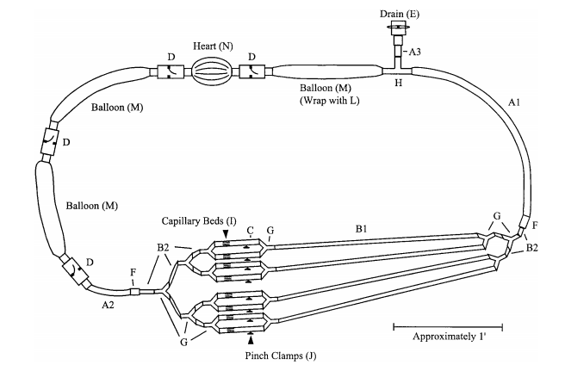
Diagram of Circulatory System Model
Notes:
Parts of System
Heart Chamber
Punching Bag Balloon
Veins and Arteries
Long Party Balloons
Arterial Balloon wrapped in plastic to provide more resistance
Capillary Beds
Clear Vinyl Tubing
PVC Connectors used to connect system

Slide 18
Circulatory System Model Specifications
Circulatory System Model for Undergraduates Specifications
Size | 10 ft in circumference (approx. 3 m)
Weight | Not specified (Lightweight assumed)
Fluid | 2-3 liters of water
Power | Mechanical
Pressure Measurements | Transducer injected via needle near capillary bed
Notes:
The system is approximately 10 ft in circumference (which means that is is approximately 3 ft across). Weight was not specified, but the system uses water as the fluid. It too uses mechanical power provided by the student pumping the punching bag balloon. A transducer is injected via needle to take pressure measurements.

Slide 19
Circulatory System Model for Undergraduates
Pros
Cons
Inexpensive
Liquid used in the system versus air
Mechanical Input
Not Sustainable/ Long Lasting
Pressure measurements by means of a needle
Notes:
Positive aspects of this device include its low cost and easy to assemble construction. Liquid makes a more realistic fluid and allows for analysis of flow through the system. Similar to Dr. Wilkinson’s model, the latex balloons must be replaced often. And while the ability to take pressure measurements is helpful, the method of using a needle and then sealing the hole with parafilm is not feasible for students while learning and is inherently inaccurate

Slide 20
Mock Circulatory Apparatus
Created by Jeremy Low and Mark Alan Von Huben
U.S. Patent 2007/0054256A1
Developed in a clinical setting
Used to understand circulatory system and to analyze it under various heart and vascular conditions
Contains:
  Mock Left Ventricle
  Reservoirs (Afterload and Preload)
  Vessels
  Valveless Pump

Slide 21
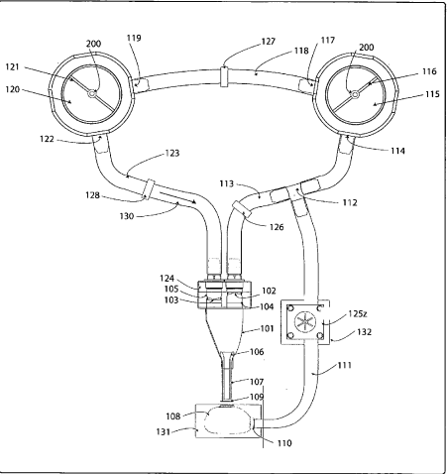
Diagram of Mock Circulatory Apparatus

Slide 22
Mock Circulatory Apparatus Specifications
Mock Cirulatory Apparatus Specifications
Size | N/A (Table-top device/Not easily movable)
Weight | N/A
Fluid | Aqueous glycol (63:37) (Amount not specified)
Power | Valveless Pump or Mechanical
Pressure Measurements | Pressure sensors in reservoirs

Slide 23
Mock Circulatory Apparatus
Pros
Cons
Use of fluid and option to measure flow velocity
Pressure Sensors
Mechanical Input
Large and Immobile
Too complicated for a non-technical user
Addition of core hole and pump
Notes:
Hofmann (same as Wilk)- no quantitative measure of resistance. Subjective.

Slide 24
Mock Circulatory System for the Evaluation of LVADs
University of Sao Paulo & Institute Dante Pazzanese of Cardiology
Evaluation of cardiac implants
  Cardiac valves, ventricular assist devices, vascular grafts, etc.
Goal: Relate flow and pressure in a quantitative way
4 Elements of Model
  Pump System
  Circulatory System
  Test Compartment module
  Acquisition and analysis monitoring system

Slide 25
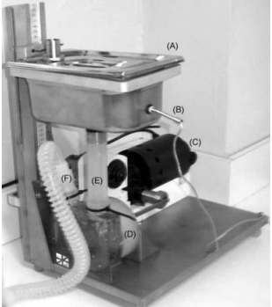
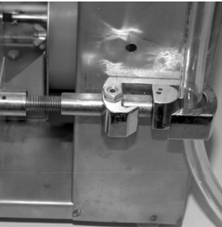
Diagram of Mock Circulatory System for Evaluation of LVADs

Slide 26
Mock Circulatory System for the Evaluation of LVADs
Mock Circulatory System for the Evaluation of LVADs
Size | Not specified; Fairly large with 4 different systems
Weight | N/A (Immobile)
Fluid | Liquid (Amount not Specified)
Power | Pump using piston against diaphragm
Pressure Measurements | Pressure transducers throughout system

Slide 27
Mock Circulatory System for the Evaluation of LVADs
Pros
Cons
Sustainable
Precise quantitative representation of left circulation
Immobile
Expensive
Requires technical background to operate
Appearance is not physiologically accurate

Slide 28
Team Organization
Notes:
With these current solutions, as well as the specifications for our design, the Teaching Heart team’s next steps are to generate several and select one design. To achieve the December deadline, the team has created a project schedule seen here.

Slide 29
Project Schedule
Notes:
The schedule includes all tasks and milestones throughout the design process. It indicates working periods for the various tasks, as well as the specific deadlines.

Slide 30
Organization of Responsibilities
Team Teaching Heart
Meet Weekly
Prepare Written Reports
Compile Weekly Status Reports
Megan
Preliminary Presentation
Project Management
Danny
Progress Presentation
Web Master
Frank
Final Presentation
DesignSafe Report
Notes:
In addition to creating a schedule, the team has worked together to create a division of responsibilities that best utilizes the strengths of each team member. Collectively, the team meets weekly to check-in on current progress and compile the weekly status reports. Additionally, the team works together to prepare the written reports.

Slide 31
Works Cited
Legendre, Daniel, Jeison Fonseca, Aron Andrade, José Francisco Biscegli, Ricardo Manrique, Domingos Guerrino, Akash Kuzhiparambil Prakasan, Jaime Pinto Ortiz, and Julio Cesar Lucchi. "Mock Circulatory System for the Evaluation of Left Ventricular Assist Devices, Endoluminal Prostheses, and Vascular Diseases."Artificial Organs 32.6 (2008): 461-67. Print.
Low, Jeremy, and Mark Alan Von Huben. Mock Circulatory Apparatus. United States, assignee. Patent US 2007/0054256A1. 8 Mar. 2007. Print.
Smith, A. M. "A Model Circulatory System for Use in Undergraduate Physiology Laboratories." Advances in Physiology Education 22.1 (1999): S92-99. PubMED. Web. 16 Sept. 2012.
Widmaier, Eric P., Hershel Raff, Kevin T. Strang, and Arthur J. Vander. Vander's Human Physiology: The Mechanisms of Body Function. 12th ed. New York: McGraw-Hill, 2011. Print.

Slide 32
Questions?

