Slide 1
Megan Foran, Danny Jones, & Frank Moynihan Dr. Bob Wilkinson, Ph.D.
Notes:
Good morning, My name is frank Moynihan, along with Megan foran and danny jones we are the teaching heart team. Our client is Dr. bob wilkinson, whose a professor at washington university school of medicine. I would like to begin this morning by briefly discussing the need and the specific design requirements, and then go into the details of the chosen design element by element, and finally I will conclude with some reflextion on the project over the entire semester

Slide 2
Need

Slide 3
Starling’s Law can be difficult for cardiophysiology students to visualize
To aid comprehension, students need an interactive learning model to supplement the lecture and reading material
The model should allow the students to control the variables of mechanical circulatory regulation:
Stroke Volume, Heart Rate, and Peripheral Resistance
Notes:
Comprehensive teaching aid that allows students to manipulate the variables of mechanical circulatory regulation using a physical model that allows students to put their brain into the process

Slide 4
Specific Design Requirements
Notes:
In order to address the needs of the client and his students, the device will conform to the following design specifications.

Slide 5
Design Specifications
Portable & Easy to Use
2-5 kg; 1-2 m in circumference
Relatively Inexpensive (<$500)
Sustainable
Discrete structures
Left ventricle, Arteries, Veins, Resistance Vessels (Capillary Bed)
Mechanical Pump (LV), controlled by student, supplies power to the system
Variable resistance in capillary bed: (0,∞)
Variable fluid volume within the system: (0,3 L)
Notes:
The device must be portable and easy to operate, the 2-5 kg and 1-2 m in circumference was chosen by the design team. It needs to be under $500. Susatainability is one of the most important factors. It should be noted that the quantitative pressure measurement was removed from the design specifications because it was an optional additional component in the design statement and not only did it put the project over budget but also it distracted from the overall simplicity and user friendliness of the device. Lets now discuss the specifics of the design

Slide 6
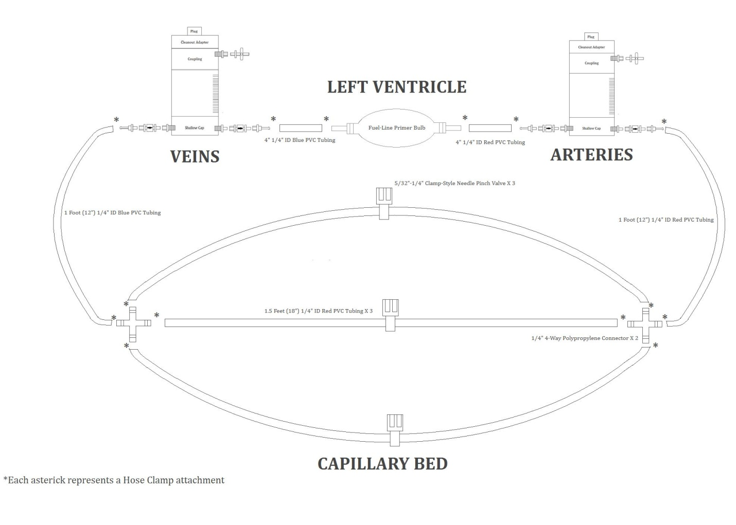
Details of the Chosen Design
Notes:
Here is a diagram of the teaching heart device

Slide 7
Elements of the Design
Biological Component
Mechanical Analog
Fluid
Left Ventricle
Arteries and Veins
Resistance Vessels
Variable Resistance Mechanism
Water
Primer Bulb
Chambers
PVC Tubing
Needle Pinch Valves
Notes:
On the left are the discrete structures of the circulatory system that need to be modeled in the device, and on the right is the mechanical analog that comprises the teaching heart model

Slide 8
Fluid
Water
Cheap
Simple
Abundant
Safe
Notes:
This is another change made in the design since our progress report, we will use water as apposed to aqueoues glycol. Water is cheap, safe, and doesn’t require mixing any solutions for the device.

Slide 9
Left Ventricle
Sierra ¼’’fuel line primer bulb
Mechanical, controlled by the student
Two valves allow for unidirectional flow
Barbed fittings
Notes:
To model the left ventricle, the iBoats Sierra ¼” fuel line primer bulb was selected because it provides the desired user inputted mechanical pumping. It also has two valves, one at each end which allows for unidirectional flow. The barbed fittings at each end are compatable with tubing that is used connect the discrete structurs

Slide 10
Sierra ¼” Fuel Line Primer Bulb
Made by iBoats
Flouroelastomer
$18.27 each
Lead time: 2-5 days
Notes:
Made from multiple layers of flouroelastomer, costs only $18.27, and has a lead time of about 2-5 days

Slide 11
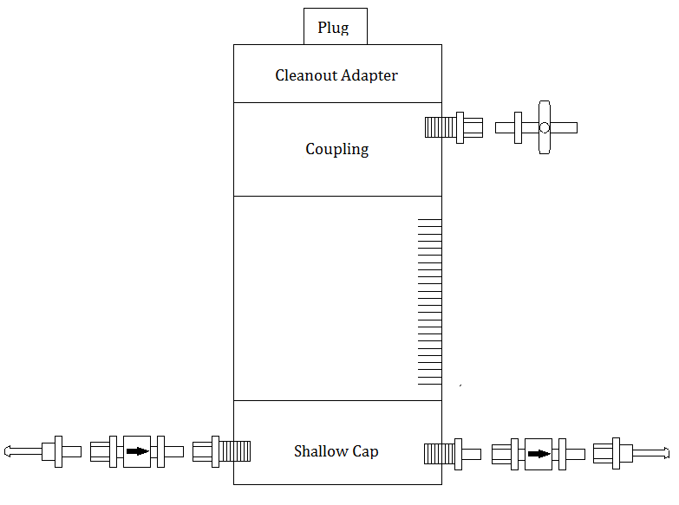
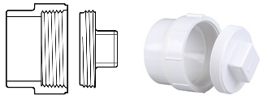
Arteries and Veins
Clear PVC chambers
Air and water levels model compliance
Graduated markings
Threaded cleanout adapter and plug
Notes:
One of the greatest challenges for the design team was determining how to create a sustainable component that exhibits the fluxuations of compliance and volume in the arteries and veins as the variables related to mechanical control are maipulated. The final design uses chambers made from clear PVC pipe to allow the users to the changes in the air and water volumes in the chamber. This component incorporates a base cap with the necessary attachments for connecting the chamber to the rest of the device. Then clear PVC tubing, with graduated marking to aid in visually interpretting changes in volume. Then a coupling is used to connect the PVC pipe to the threaded cleanout adapter and plug.

Slide 12
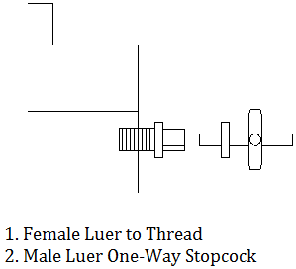
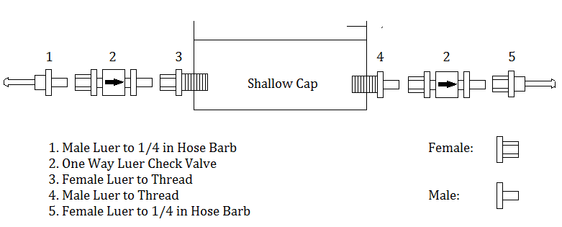
Arteries & Veins
Variable compliance stopcock
Shallow base cap
$171.81 each
Lead time: 1-2 weeks
Notes:
The chamber will also have a variable compliance stopcock which allows the level of the air and water in the chamber to be adjusted once the device has been filled. Here we see a the specifics of the shallow base cap also. All together this costs about 171 dollars and 81 cents and has a lead time of about 1 to 2 weeks

Slide 13
Resistance Vessels
¼” PVC tubing
Low rigidity
Durable
Low costs
Variety of sizes and fittings
Lead time: 2-5 days
Notes:
The resistance vessels will be made from ¼” PVC tubing, its ideal because of its low rigidity, durability, its relatively inexpensive and it comes with a variety of fittings as well as fits with all the discrete components of the design. It will costs around $20 for all the necessary tubing, will be obtained from McMaster Carr, has a lead time of about 2-5 days

Slide 14
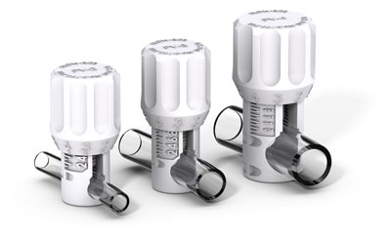
Resistance Mechanism
Needle Pinch Valves
Durable
Low cost: $41.00
Mechanical Input
Safe
Compact Size
Resistance (0,∞)
Notes:
For the resistance mechanism Needle Pinch valves were chosen, because their relatively inexpensive, they offer user controlled input, cover the desired range of resistance values. These will also be obtain from McMaster Carr and have a lead time of 2-5 days

Slide 15
Notes:
Here again is the diagram of the design

Slide 16
Conclusions
Notes:
Let me breifly conclude with some reflections on the project

Slide 17
Did we solve the problem?
Improved sustainability
Consistent visual feedback
Improved resistance mechanism
Increased user-friendliness and simplicity
Notes:
The design team firmly believes we solved the problem and meet the clients needs. The device will be highly sustainble. The device gives much more consistent visual feedback. The resistance mechanism is simple and intuitive, and the overall user-friendliness of the teaching heart device has been improved

Slide 18
Future Directions
Teaching Heart team will not continue on to BME402
Willing to stay in touch with the client to provide necessary support

Slide 19
What was learned?
Communication is key, working together much more effective
Realistic goals and deadlines

Slide 20
What would be done differently?
Improve communication with client, focus on the clients needs
More innovative design concept
More specific project management
Notes:
Improved commmunication with the client, and focus on the client’s needs more as opposed to fitting our design to the course expectations. Also initially we should have thought more about innovation rather than optimization of the existing protoype. More clearly defined tasks as well more concrete deadlines for the team members could have been beneficial. We found that working together at the same time to be much more productive that separating to do individual task, so that would have been incorporated at an earlier time in the design process

Slide 21
Intellectual Property
Teaching Heart team not seeking IP
Relinquishing any potential IP to the client

Slide 22
Works Cited
Chamber, luer valves and fittings, adapters <http://www.coleparmer.com/>
PVC pipe, fittings,valves <http://www.muellerindustries.com/products>
Tubing, valves, fittings <http://www.mcmaster.com/>.
"Primer Bulb." EPA Certified S : Attwood Marine. Attwood Marine Products. http://www.attwoodmarine.com/store/product/epa-certified-primer-bulb.
US Plastics <www.usplastic.com>.

Slide 23
Questions?

